Slide 1

Presigned URLs in CDL Merritt System
Terry Brady, Marisa Strong

Slide 2

CDL - California Digital Library https://cdlib.org/
CDL provides transformative digital library services, grounded in campus partnerships and extended through external collaborations, that amplify the impact of the libraries, scholarship, and resources of the University of California
Four active programs:
Publishing, Access, and Digitization (PAD)
Discovery & Delivery (D2D)
Collections & Licensing
UC Curation Center (UC3)
Infrastructure and Application Support (IAS) team

Slide 3

UC3 - University of California Curation Center
https://uc3.cdlib.org/
Digital Curation: maintaining, preserving, and adding value to digital research data throughout its lifecycle
UC3 currently focuses on:
Research data management
Data publishing
Data/software skills training for librarians
Persistent identifiers
Digital Preservation

Slide 4
Merritt System (merritt.cdlib.org)
Digital Preservation System
Decades long storage
150TB of unique content
3 Copies (450TB)
Distributed to 3 geographic regions
2.3 M objects
50 million unique files
Some objects as large as 250+ GB
UC Content - From 10 campuses
Dryad Content - From 2000+ institutions
85 journals published by CDL
9 microservices on 24 servers

Slide 5
Digital Preservation Repository (DPR)
Precursor system
SDSC
Scalable, High Performance Cloud Storage Adopted
2010
2015
2006
2011
Merritt System
Curation Microservices based system
Migrate to AWS Servers
Transition from physical Sun/Solaris servers to Amazon Web Services infrastructure
2020
Make use of additional cloud development patterns to make systems more flexible and resilient

Slide 6
“Files” in Merritt are stored in cloud storage
Merritt utilizes multiple cloud storage providers
Amazon S3 and Glacier
Minio from SDSC
Wasabi
my.pdf

Slide 7
“Objects” in Merritt have digital files and metadata
Objects in Merritt contain one or many digital files
my.pdf
my.xml

Slide 8
Our Challenge
Situation:
⇧ volumes of content
⇧ size of objects being requested
⇧ user traffic
Problem: Large Object Requests
Tie up existing resources
Make it more difficult to perform system maintenance

Slide 9
How we simplified our system with Presigned URL’s

Slide 10
What is a Presigned URL?
We have a file in cloud storage that is not publicly available
Cloud Storage
File
(access restricted)

Slide 11
Our Initial Approach: Use a Web Server
Web Server
Cloud Storage
File
(access restricted)

Slide 12
User Requests the File from a web server
User
Web Server
Cloud Storage
File
(access restricted)

Slide 13
The Web Server Retrieves the File
User
Web Server
Cloud Storage
File
(access restricted)

Slide 14
The Web Server Delivers the File to the User
User
Web Server
Cloud Storage
File
(access restricted)

Slide 15
What if the File is 50GB in size?
User
Web Server
Cloud Storage
50 GB File
(access restricted)

Slide 16
Our New Approach: Use Presigned URL’s
User
Presigned URL’s are supported by the 3 cloud storage providers that Merritt uses!
Web Server
Cloud Storage
File
(access restricted)

Slide 17
User Requests the File from a web server
User
Web Server
Cloud Storage
File
(access restricted)

Slide 18
The Web Server Requests a Presigned URL
User
Web Server
Cloud Storage
File
(access restricted)

Slide 19
The Presigned URL is returned to the User
User
Web Server
Cloud Storage
File
(access restricted)

Slide 20
User Retrieves the File Directly from Cloud Storage
User
Presigned URL’s are good for a limited time.
Presigned URL’s are long and complex and would not be likely to be guessed by a malicious user.
Web Server
Cloud Storage
File
(access restricted)

Slide 21
Presigned File Requests were Recently Added to Merritt
Merritt User
Merritt User Interface
Merritt Storage Service
my.pdf
Dryad
User
Dryad User Interface

Slide 22
User is redirected to Cloud Storage with the “Presigned URL”
User Requests File
Merritt User Interface
Merritt Storage Service
my.pdf
User Requests File
Dryad User Interface
The downloaded bytes are streamed directly from the cloud provider.

Slide 23
Merritt Object Download
A Merritt Object can contain one file or thousands of files
A Merritt Object request must be assembled into a zip file
Some requests are very large 200+ GB
Our initial implementation varied by the size of the object

Slide 24
Before: Merritt/Dryad User Requests an Object (Regular Size)
Merritt User
Merritt User Interface
Merritt Storage Service
my.pdf
my.xml
Dryad User
Dryad User Interface

Slide 25
Before: Merritt Storage Service Assembles Object on Local Disk (Regular Size)
User Requests File
Merritt User Interface
Merritt Storage Service
my.pdf
my.xml
User Requests File
Dryad User Interface
my.zip

Slide 26
Before: Content Streams through Merritt/Dryad Services (Regular Size)
User Requests File
Merritt User Interface
Merritt Storage Service
my.pdf
my.xml
User Requests File
Dryad User Interface
my.zip

Slide 27
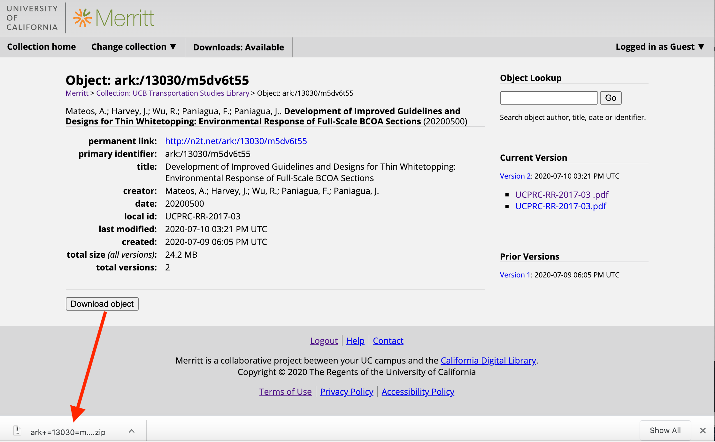

Slide 28
Before: Merritt/Dryad User Requests Version/Object (Large Size)
User Requests File
Merritt User Interface
Merritt Storage Service
my.pdf
my.xml
User Requests File
Dryad User Interface

Slide 29
Before: Merritt Storage Service Assembles Object on Cloud Storage (Large Size)
User Requests File
Merritt User Interface
Merritt Storage Service
my.pdf
my.xml
User Requests File
Dryad User Interface
big.zip

Slide 30
Before: User is notified of large object availability (Large Size)
User Requests File
Merritt User Interface
Merritt Storage Service
my.pdf
my.xml
User Requests File
Dryad User Interface
email
big.zip
Email notification has been problematic for many Dryad users

Slide 31
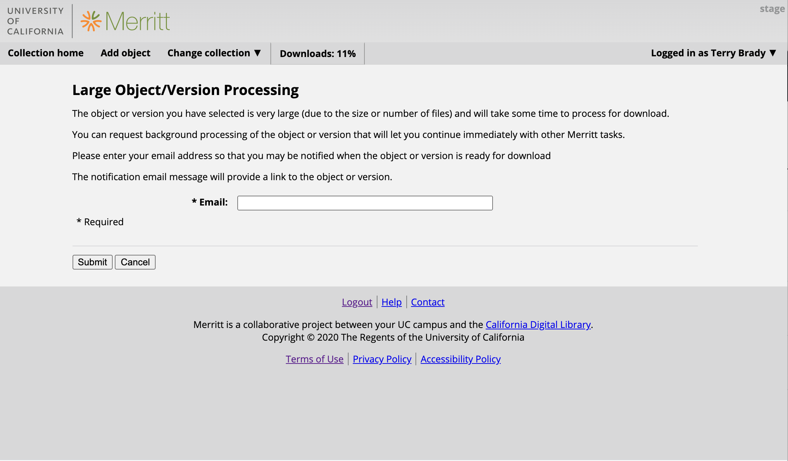
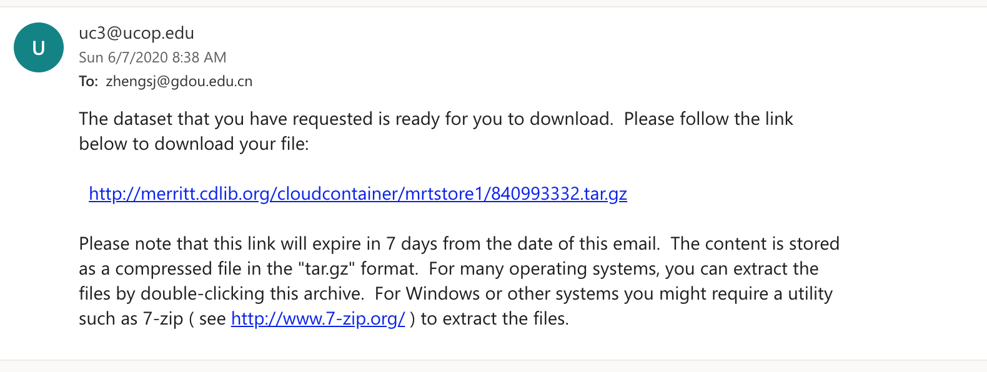

Slide 32
Before: User streams content from Cloud Storage (email link) (Large Size)
User Requests File
Merritt User Interface
Merritt Storage Service
my.pdf
my.xml
User Requests File
Dryad User Interface
big.zip

Slide 33
Introducing Presinged URL’s

Slide 34
After: Merritt/Dryad User Requests an Object (Any Size)
Merritt User
Merritt User Interface
Merritt Storage Service
my.pdf
my.xml
Dryad User
Dryad User Interface

Slide 35
After: User is returned a token to track progress (Any Size)
User Requests File
Merritt User Interface
Merritt Storage Service
my.pdf
User Requests File
Dryad User Interface
This gives us the ability to process requests as system resources are available.
my.zip

Slide 36
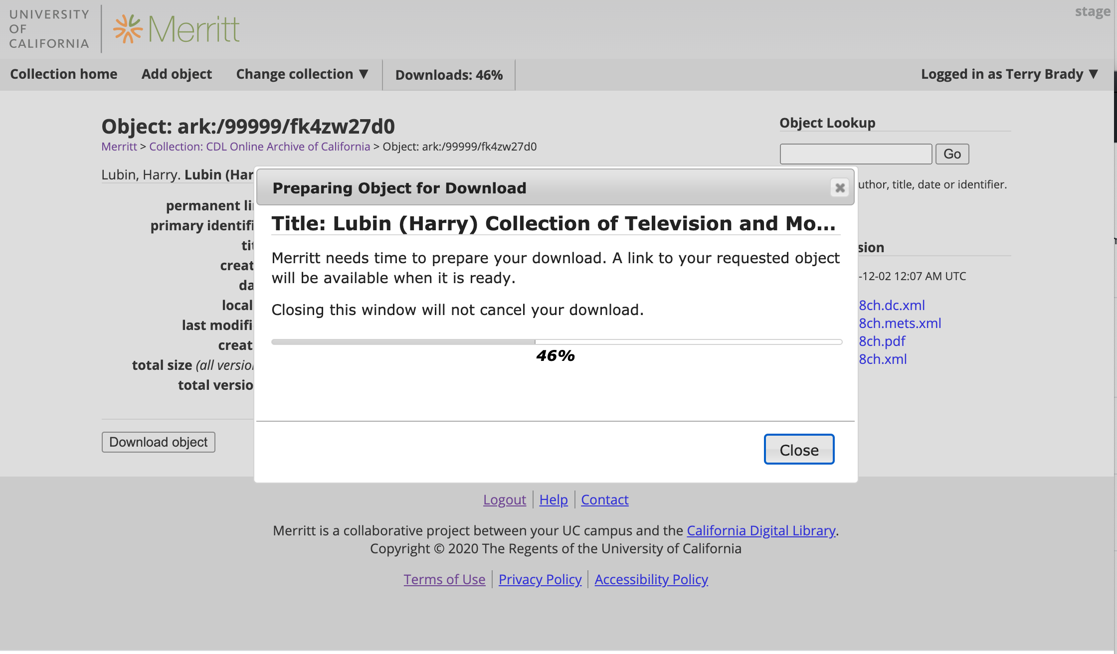

Slide 37
After: Merritt Assembles the Object on Cloud Storage (Any Size)
User Requests File
Merritt User Interface
Merritt Storage Service
my.pdf
my.xml
User Requests File
Dryad User Interface
The content is assembled in a cloud storage bucket that will automatically purge content after a predetermined amount of time (1-2 days).
my.zip

Slide 38
After: User checks token availability… A presigned URL is returned when ready (Any Size)
User Requests File
Merritt User Interface
Merritt Storage Service
my.pdf
User Requests File
Dryad User Interface
Dryad supports some high demand content. Dryad is caching tokens to facilitate re-use of objects.
my.zip

Slide 39
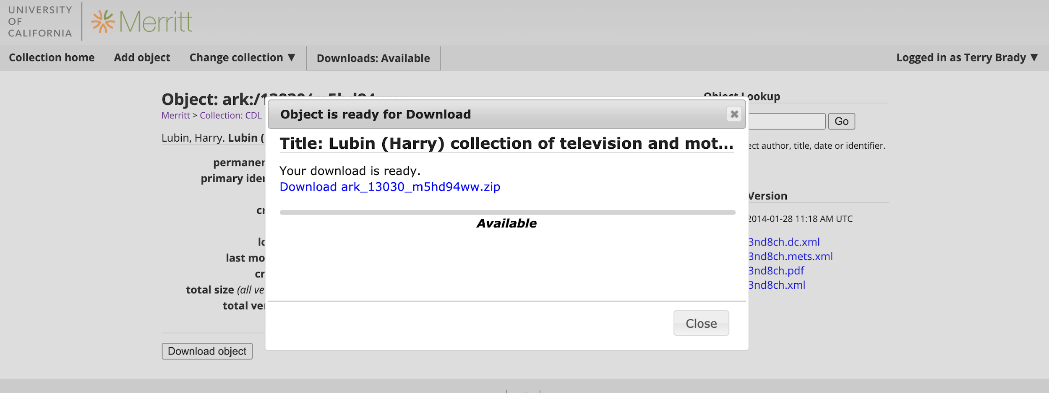

Slide 40
After: User streams content from Cloud Storage (Any Size)
User Requests File
Merritt User Interface
Merritt Storage Service
my.pdf
my.xml
User Requests File
Dryad User Interface
big.zip

Slide 41
AWS Cost Impacts
Cost Item | Description | Net Change
Storage of Files in Merritt |  | No change
Storage of Assembled Objects | All assembled objects are stored in cloud storage for a finite time | Some incremental cost based on the retention period
Data transfer charges out of cloud providers. |  | No change
Compute/IO to stream content. | Client requests will go directly to the storage providers | Less I/O on servers. Servers easier update without long running retrievals.

Slide 42
Other Impacts
Reduced data throughput on specific Merritt and Dryad services
More flexibility in deploying additional backend Merritt Services
By avoiding long running download requests
Improved user experience for Dryad users
Plans to adopt presigned URL’s for ingest of content

Slide 43
More Information
Merritt System: https://merritt.cdlib.org/
Merritt Code: https://github.com/CDLUC3/mrt-doc
Presigned Endpoint Design:
https://github.com/CDLUC3/mrt-doc/blob/master/endopoints/pre-signed-urls.md

